Slide 1
Edwards SAPIEN 3 Transcatheter Pulmonic Valve Delivery System
20 / 23 / 26 / 29 mm Sizes
Pulmonic Procedural Training Manual
See instructions for use for full prescribing information, including indications, contraindications, warnings, precautions and potential adverse events
Edwards Confidential. Do not reproduce or distribute.
DOC-0250104 Rev A

Slide 2
Table of contents
System overview
Procedural steps
04
Procedural animation
22
RVOT angiogram
05
Edwards SAPIEN 3 pulmonic delivery system overview
23
Wire exchange and placement
24
Coronary occlusion assessment
Device specifications
08
29
Landing zone sizing
Edwards SAPIEN 3 THV
11
30
Prestenting considerations
Edwards SAPIEN 3 pulmonic delivery system
20
31
Pulmonic SAPIEN 3 THV sizing
Recommended equipment
33
Verify pulmonic THV orientation
35
Delivery system and inline sheath insertion

Slide 3
Table of contents
Procedural steps (cont’d)
Procedural steps (cont’d)
37
Tracking the THV into landing zone
47
SAPIEN 3 Pulmonic delivery system removal
39
THV positioning
51
Post-deployment THV assessment
40
Retracting the valve capsule
Intraprocedural considerations
41
Verify position of THV
53
Removing undeployed delivery system
42
Rapid pacing protocol - optional
54
Balloon rupture
43
THV deployment
45
Post-dilation (if necessary)
46
Withdrawing the SAPIEN 3 Pulmonic delivery system

Slide 4
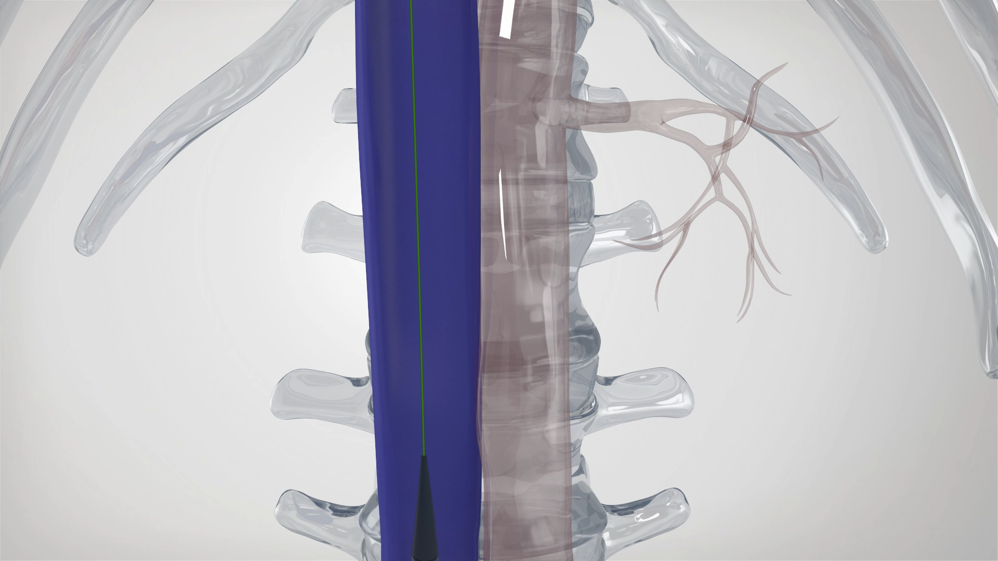
Edwards SAPIEN 3 Pulmonic System
Procedural animation of the THV pulmonic procedure
Click above to pause/play video

Slide 5
Edwards SAPIEN 3 pulmonic delivery system overview

Slide 6
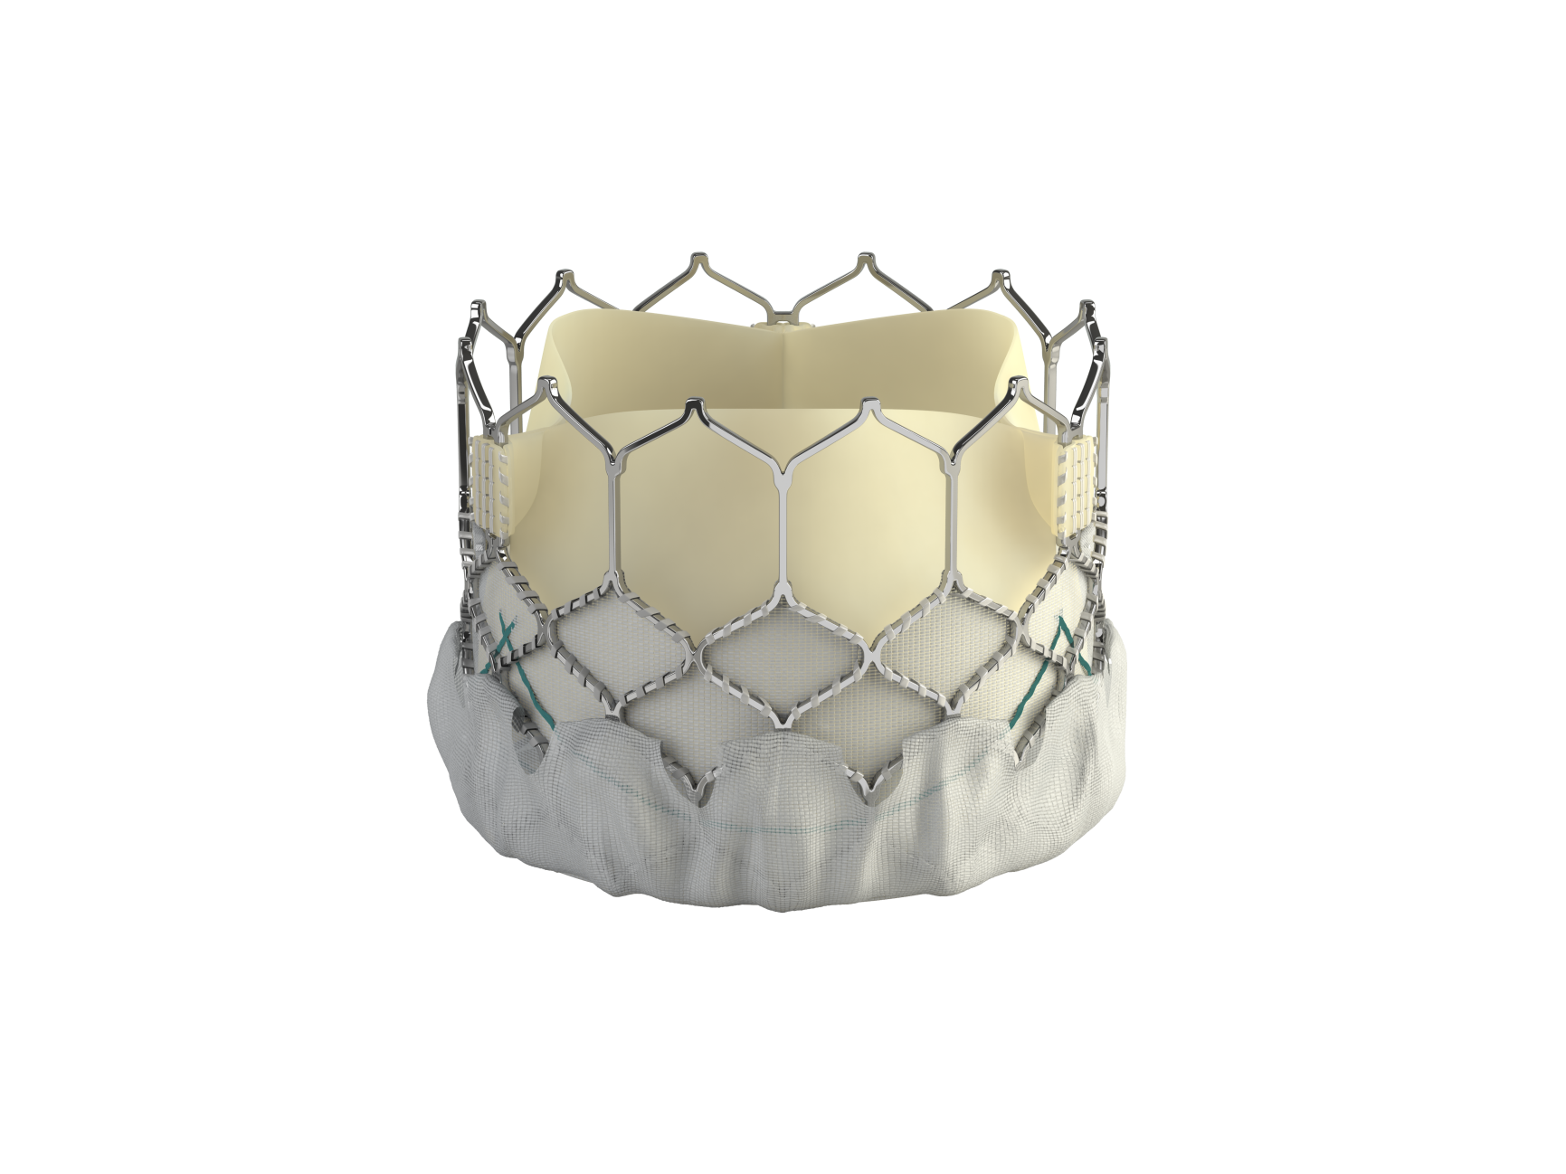
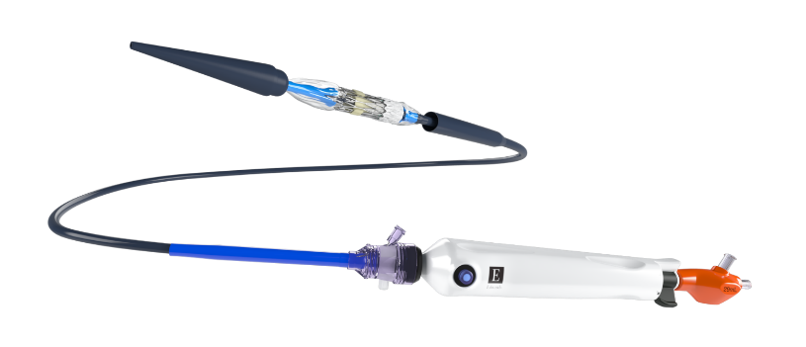
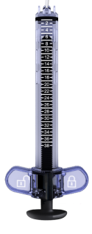
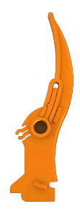
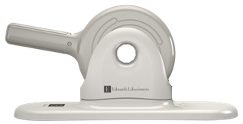
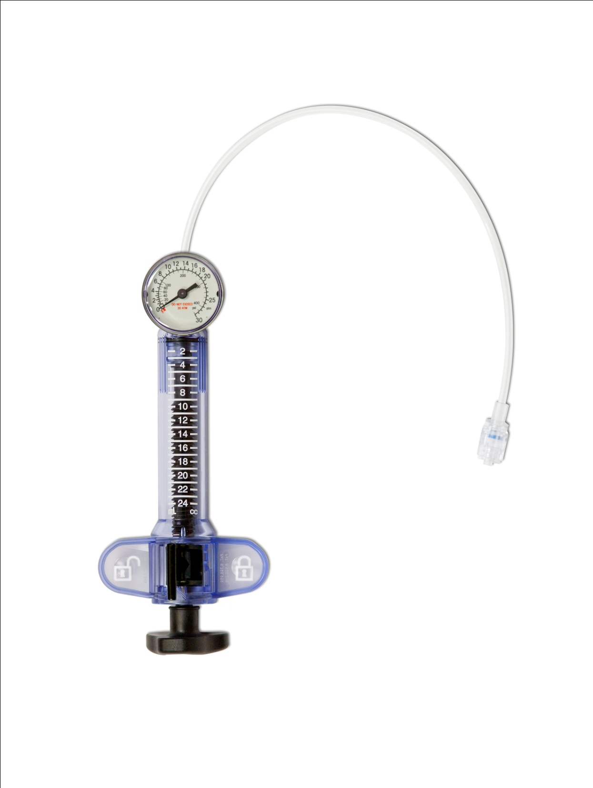
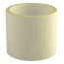
SAPIEN 3 Pulmonic system with the SAPIEN 3 Transcatheter heart valve
Edwards
SAPIEN 3
Transcatheter
heart valve
Pulmonic
delivery
system
Color-coded system
Pink
20 mm THV
Green
23 mm THV
Purple
26 mm THV
Orange
29 mm THV
Crimper
Inflation devices
Accessories

Slide 7
Device specifications

Slide 8
Edwards SAPIEN 3 THV
Bovine pericardial tissue
Scalloped leaflet shape
Carpentier-Edwards ThermaFix* process is intended to minimize the risk of calcification
Inner skirt
Polyethylene terephthalate (PET)
Outer skirt
PET outer skirt designed to minimize paravalvular leak
* No clinical data are available which evaluate the long-term impact of the Carpentier-Edwards ThermaFix process in patients.

Slide 9
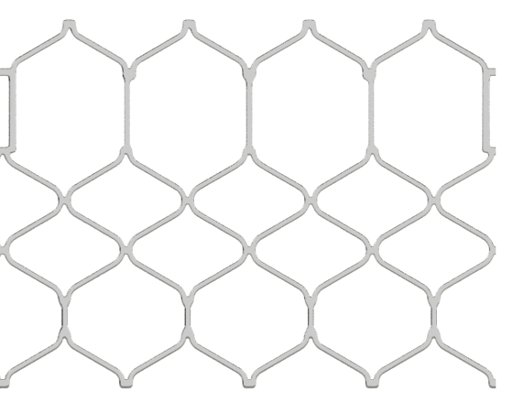
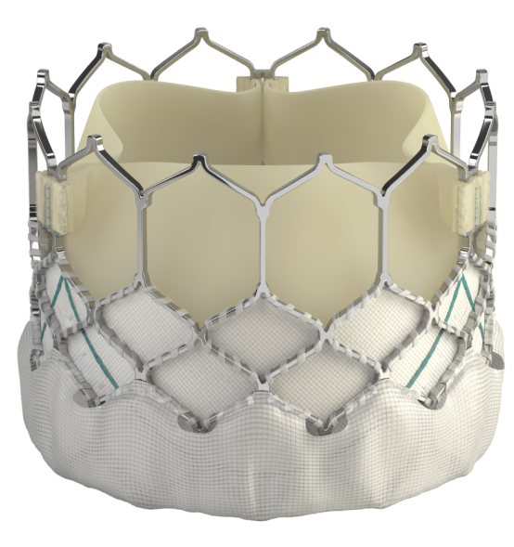
Edwards SAPIEN 3 THV
Frame design
Wide strut angles contribute to
ultra-low delivery profile
Four rows and columns between commissures for high radial strength
Cobalt-chromium alloy frame and wide strut angles provide fatigue resistance and high radial strength
for circularity
Avg radial strength (bar)
Edwards Lifesciences internal data: 2-sample t-test to determine avg radial strength of Edwards frames for SAPIEN 3 > SAPIEN XT, P <.05

Slide 10
Edwards SAPIEN 3 THV
 | 20 mm | 23 mm | 26 mm | 29 mm
Tissue | Bovine pericardium, ThermaFix tissue treatment¹
Frame | Cobalt-chromium alloy
Noncompliant landing zone size during balloon predilation | 16.5 - 20 mm | 20 - 23 mm | 23 - 26 mm | 26 - 29 mm
Crimped height² | 21 mm | 24.5 mm | 27 mm | 31 mm
Expanded height | 15.5 mm | 18 mm | 20 mm | 22.5 mm
Foreshortening | 5.5 mm | 6.5 mm | 7 mm | 8.5 mm
Inner skirt height³ | 7.9 mm | 9.3 mm | 10.2 mm | 11.6 mm
Outer skirt height | 5.2 mm | 6.6 mm | 7.0 mm | 8.1 mm
¹ No clinical data are available which evaluate the long-term impact of the Edwards Lifesciences tissue treatment in patients.
² Rounded to the nearest 0.5 mm
³ Measured at bottom of zigzag

Slide 11
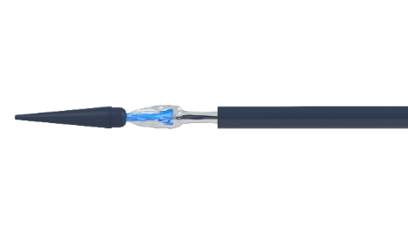
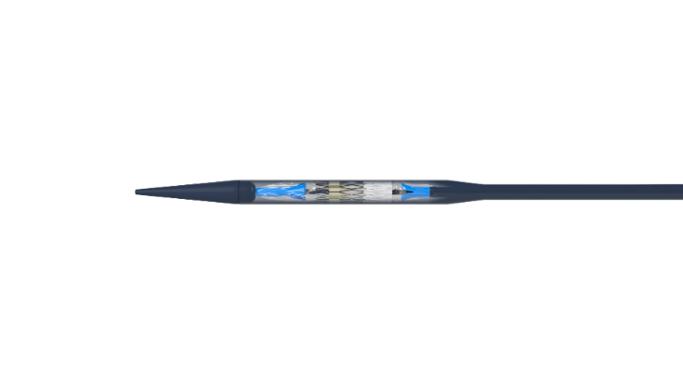

SAPIEN 3 Pulmonic delivery system overview
Valve crimped
directly on balloon
Valve capsule to cover valve
Balloon folding technology simplifies
the procedure
Eliminates valve alignment and flex catheter retraction steps
Designed for valve deliverability
Valve capsule to cover SAPIEN 3 valve
Hydrophilic coating
on tapered tip and
valve capsule
Tapered tip to facilitate tracking
Inline sheath
Color coded gripper

Slide 12
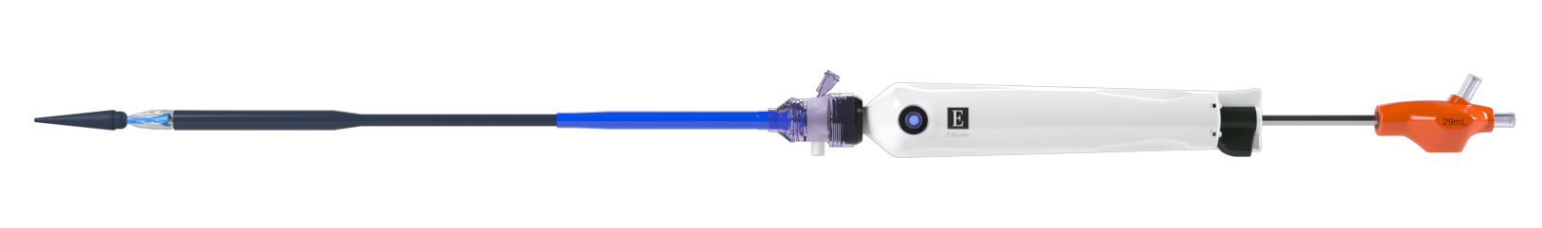
SAPIEN 3 Pulmonic delivery system – Specifications
112 cm
Effective length balloon uncovered (all sizes)
42 mm
Tapered tip
(all sizes)
Pulmonic
delivery system
Guidewire
compatibility
0.035”
THV size | Catheter capsule outer diameter
20 mm | 25.1Fr / 8.4 mm
23 mm | 27.1Fr / 9.0 mm
26 mm | 27.1Fr / 9.0 mm
29 mm | 28.5Fr / 9.5 mm

Slide 13
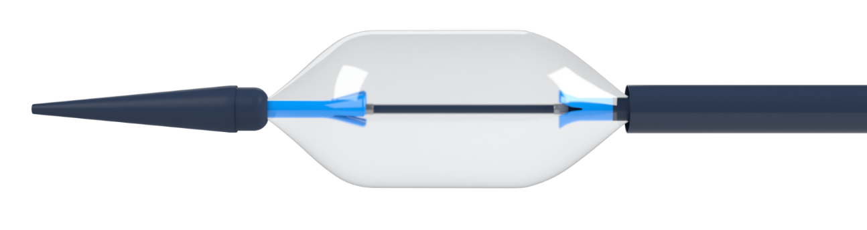
Edwards Pulmonic delivery system – Balloon
Balloon dimensions | 20 mm | 23 mm | 26 mm | 29 mm
Balloon length shoulder-to-shoulder (A) | 24 mm | 28 mm | 30 mm | 34 mm
Proximal shoulder-to-nosecone (B) | 8.0 cm | 8.6 cm | 9.1 cm | 9.5 cm
A
THV Size | Nominal inflation volumes* | Rated burst pressures
20 mm | 10 mL | 9 atm
23 mm | 15 mL | 9 atm
26 mm | 21 mL | 9 atm
29 mm | 29 mL | 9 atm
B
* The delivery system requires a prescribed volume for THV deployment and proper function

Slide 14
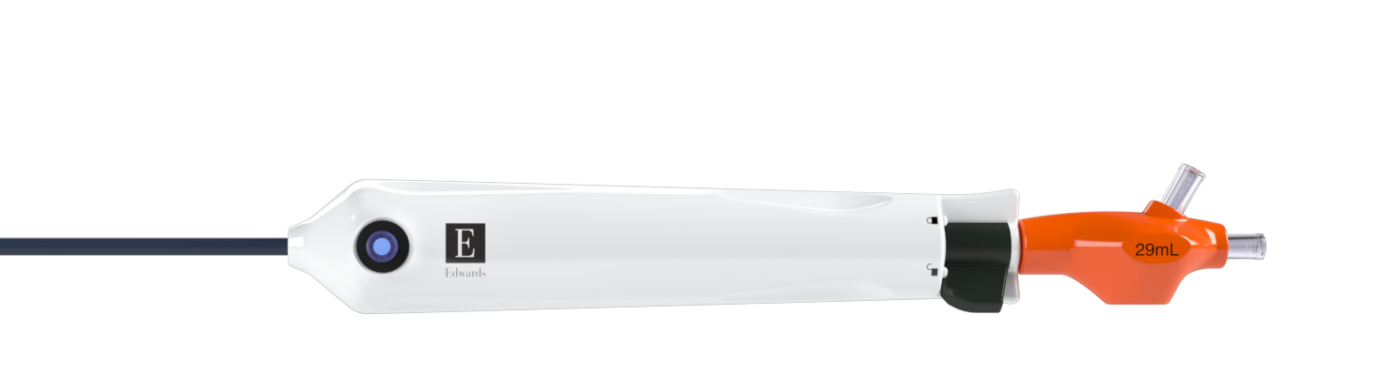
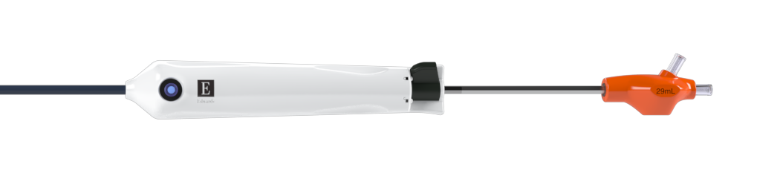
SAPIEN 3 Pulmonic delivery system – Handle
Delivery system lock
Color-coded gripper
Inflation volume
Balloon inflation port
Outer shaft
Balloon shaft marker
Balloon shaft
Guidewire lumen
Flush port

Slide 15
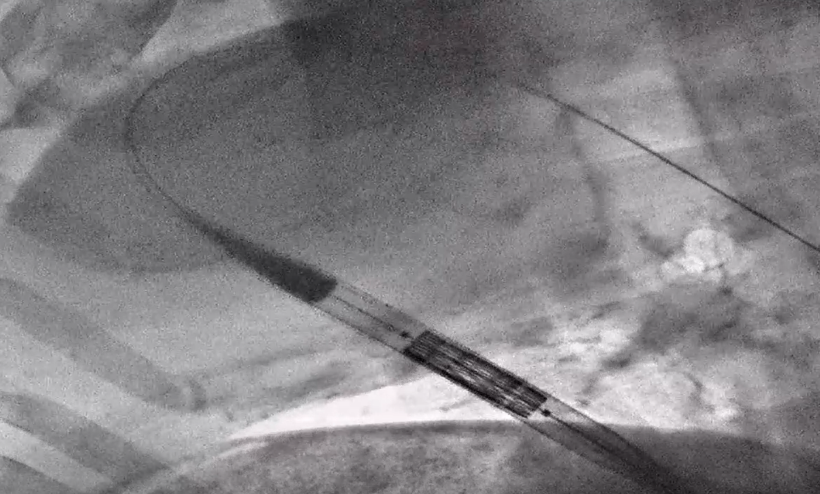
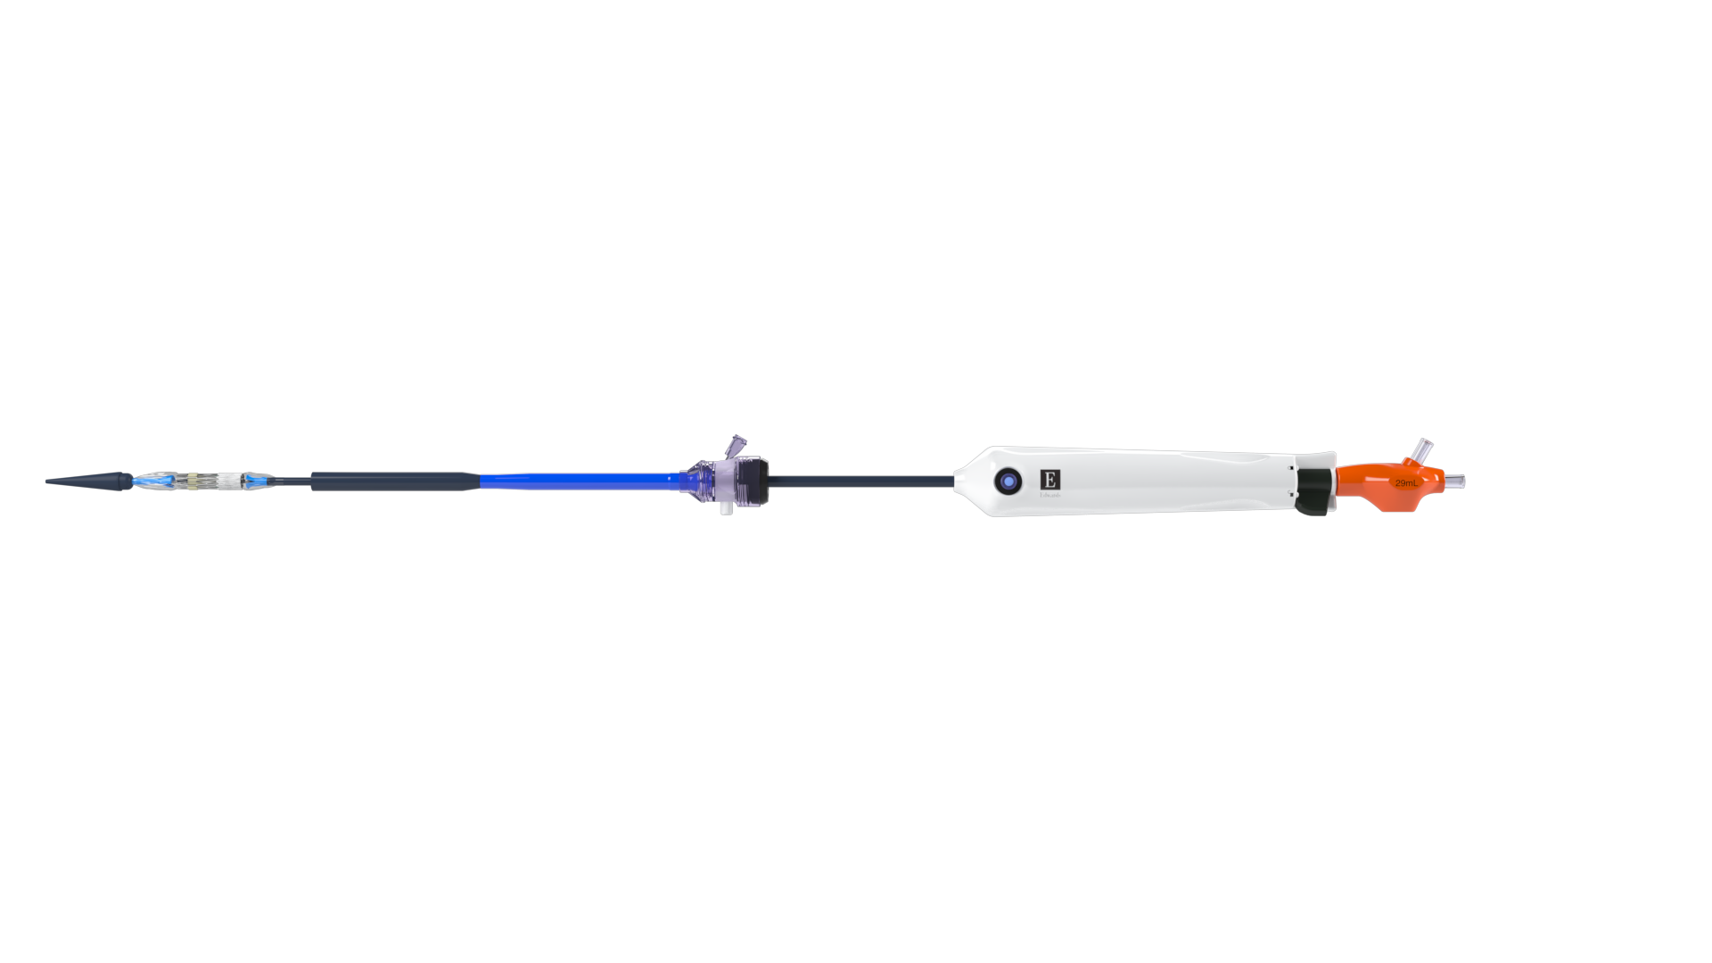
SAPIEN 3 Pulmonic delivery system – Distal end
Valve is covered by capsule until valve is positioned in desired location
Valve is crimped directly on balloon
(no valve alignment)
Radiopaque shoulder markers
Tapered tip
Valve capsule
Internal shoulders
(underneath balloon)
Balloon
shaft
Tapered tip
Valve capsule
Animal model shown for illustration

Slide 16
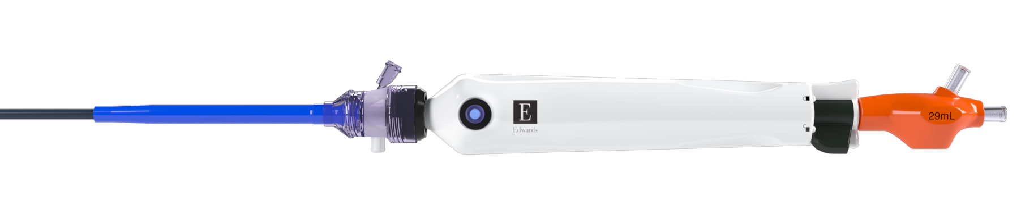
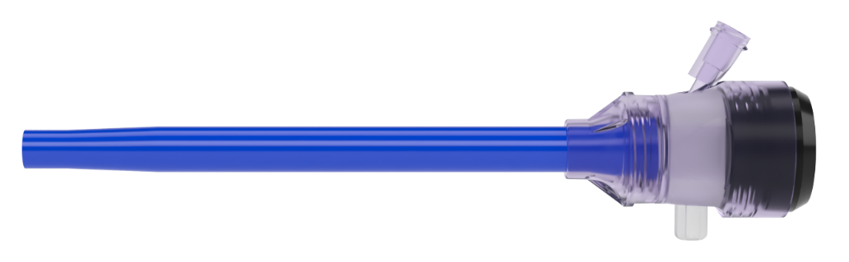

SAPIEN 3 Pulmonic delivery system – Inline sheath
25.5Fr / 8.5 mm
outer diameter
(all sizes)
Flush port
    The inline sheath does not come off the delivery system. Shown separately for illustrative purposes.
NOTE
10 cm
effective length

Slide 17
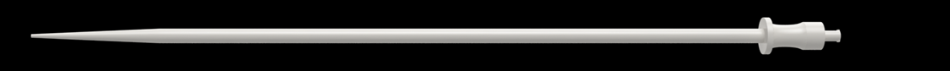
SAPIEN 3 Pulmonic delivery system – Dilators
THV size | Provided dilator size
20 mm | 25Fr
23 mm | 27Fr
26 mm | 27Fr
29 mm | 28Fr
40 cm all sizes

Slide 18




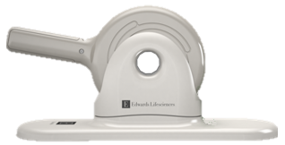
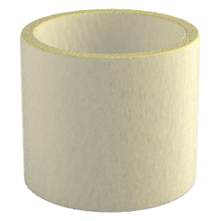
Crimper, Qualcrimp, and 2-piece crimp stopper
Additional components used during device preparation
  Crimper is the same for all THV sizes and is packaged separately
  Qualcrimp crimping accessory is designed to protect the THV leaflets when crimping to a low profile and is packaged with the delivery system
  Color-coded 2-piece crimp stopper is used during crimping and is packaged with the delivery system
Crimper
Qualcrimp crimping accessory
2-piece crimp stopper
20 mm
23 mm
26 mm
29 mm

Slide 19
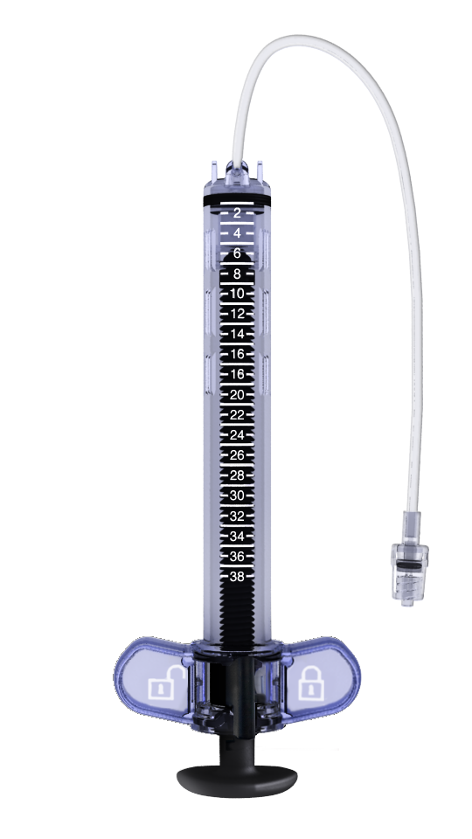
Inflation devices
Inflation devices are used for deployment of the THV and predilation balloon
Volume-based inflation
Lock / unlock symbols on handle
1 mL graduation marks for volume accuracy
Inflation device (25 mL)
Used with the 20 mm, 23 mm, and 26 mm THV systems
Locking Syringe (38 mL)
Used with the 29 mm THV system
Customized long narrow barrel for inflation
with large volumes
Pressure gauge removed for device placement during inflation
For use with
20 / 23 / 26 mm
THV systems
For use with
29 mm
THV system

Slide 20
Recommended equipment
Room equipment
Sterile table equipment
Vascular dilators
Balloon tip catheter
Angiographic catheters
Exchange length 0.035" (0.89 mm) extra-stiff guidewires:
i.e., Lunderquist, Meier, Amplatz extra stiff
Intra-cardiac echocardiographic system (optional)
Vascular closure devices
Large bore short sheath
Temporary pacemaker and pacing leads
Liter heparinized saline
Liter normal 0.9% saline
Standard cardiac catheterization lab equipment
Fluoroscopy (bi-plane, fixed, mobile or semi-mobile fluoroscopy systems appropriate for use in percutaneous coronary interventions)
6 sterile rinsing basins
  2 – physiological saline (1 liter) – valve rinsing
  2 – physiological saline (1 liter) – Qualcrimp rinsing
  1 – heparinized saline (1 liter) – flushing
  1 – diluted radiopaque contrast medium (15 cc contrast: 85 cc saline)
20 cc syringes or larger
50 cc syringes or larger
High-pressure 3-way stopcock
Prep table
Sterile forceps
Sterile scissors
Equipment provided by Edwards Lifesciences
Edwards SAPIEN 3 valve
Edwards Pulmonic delivery system
Edwards crimper
Edwards provided inflation device

Slide 21
Procedural steps

Slide 22
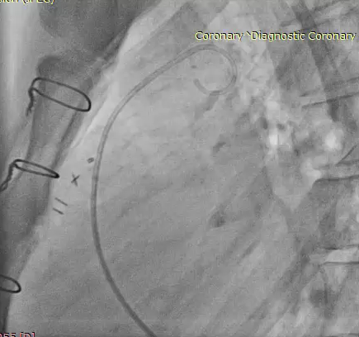
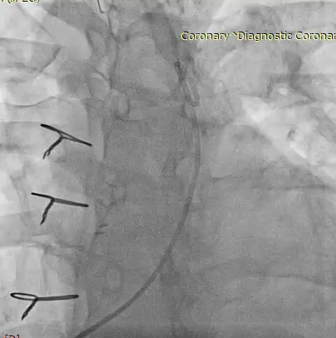
RVOT angiography
Biplane angiography
Assess proposed site for implantation
Quantification of pulmonary regurgitation and/or stenosis
Click above to pause/play video
Click above to pause/play video

Slide 23
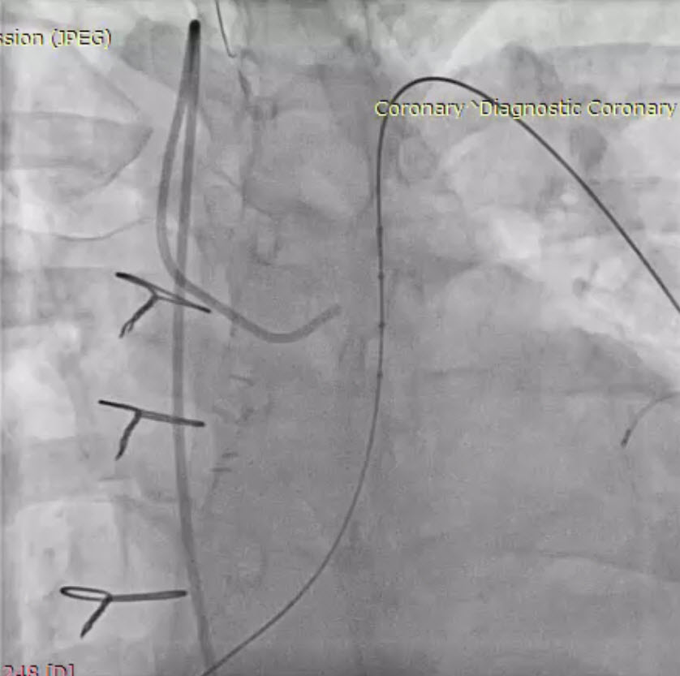
Wire exchange and placement
Wire positioned in a distal pulmonary branch
  Preferably the left lower branch given its vertical orientation
Exchange to a 0.035” exchange length
stiff guidewire
  i.e., Lunderquist (Cook) or Meier
  (Boston Scientific)
  Stiff wires are recommended to assist
  with tracking of the delivery system

Slide 24
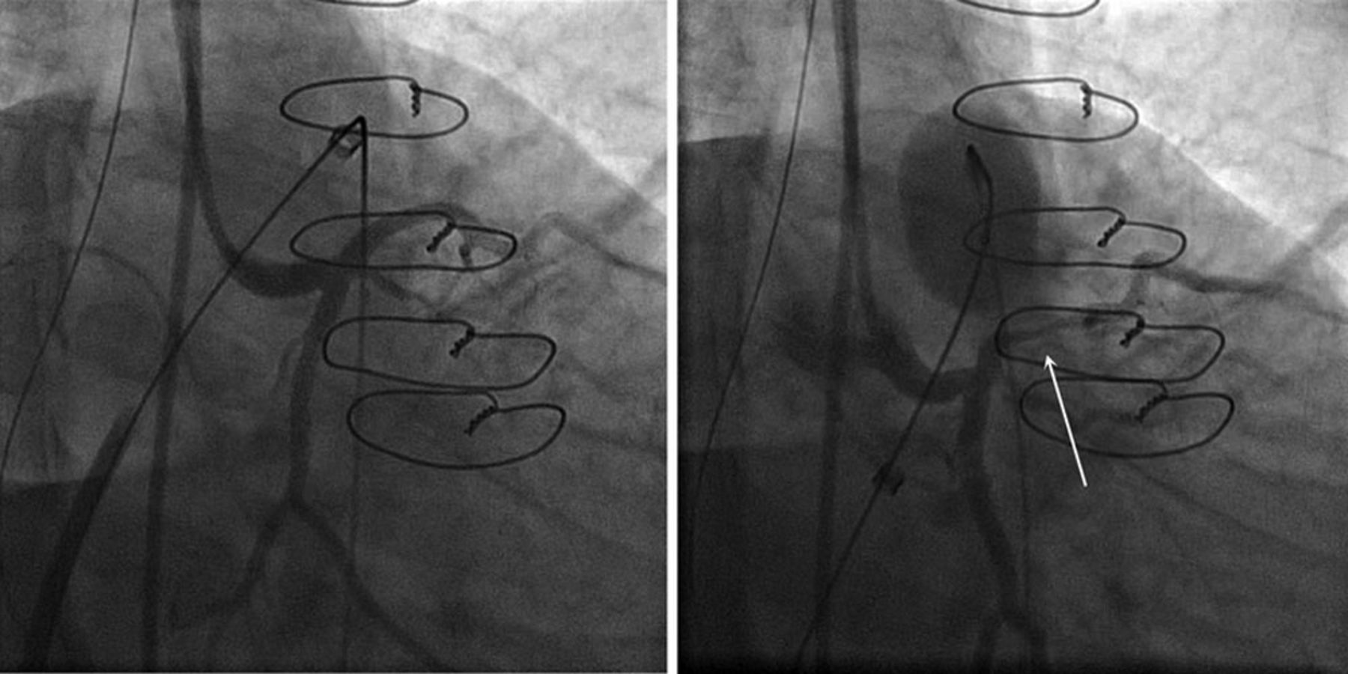
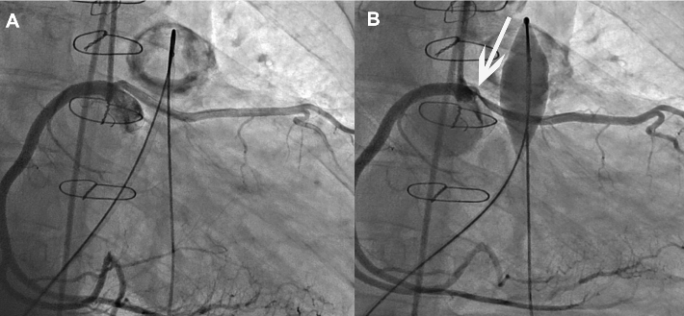
Coronary occlusion assessment
Rotational and/or biplane coronary angiography (typically lateral and LAO / CAU) profiles the left coronary well
Balloon sized to the final anticipated size of landing zone
Ensure the presence of at least 10 mm from the edge of the inflated balloon to the origin of the coronary arteries
Either coronary can be compromised; although typically, it is the left main and/or left anterior descending
Image: Morray et al. Risk of Coronary Artery Compression Among Patients Referred for Transcatheter Pulmonary Valve Implantation: A Multicenter Experience
Image: Wilson et al. Evolving trends in interventional cardiology: endovascular options for congenital disease in adults

Slide 25
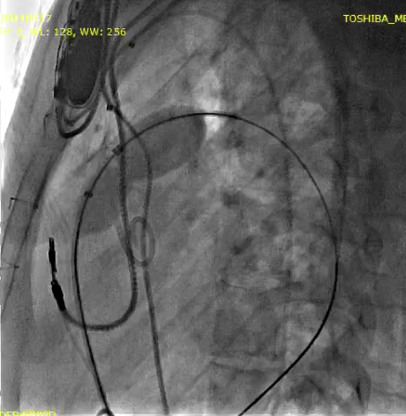
Coronary occlusion assessment
Example 1
Nonselective technique
Click above to pause/play video

Slide 26
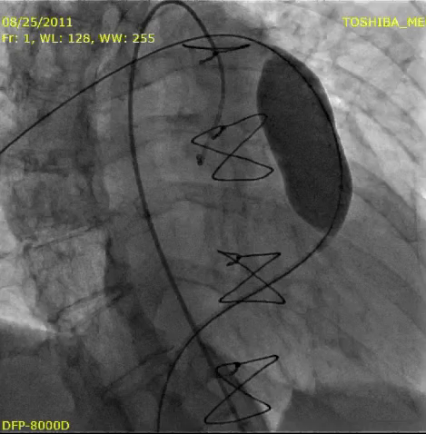
Coronary occlusion assessment
Example 2
Selective left coronary angiography
Click above to pause/play video

Slide 27
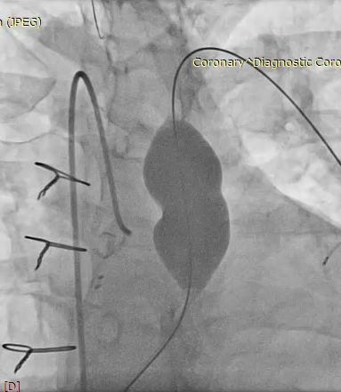
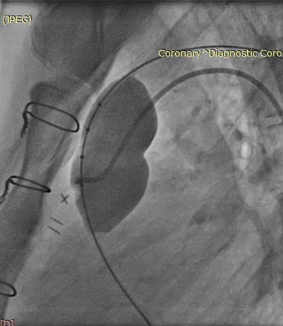
Coronary occlusion assessment
Assess coronaries utilizing multiple angles
Click above to pause/play video
Click above to pause/play video

Slide 28
Coronary occlusion assessment
Check for remote coronary artery compression

Slide 29
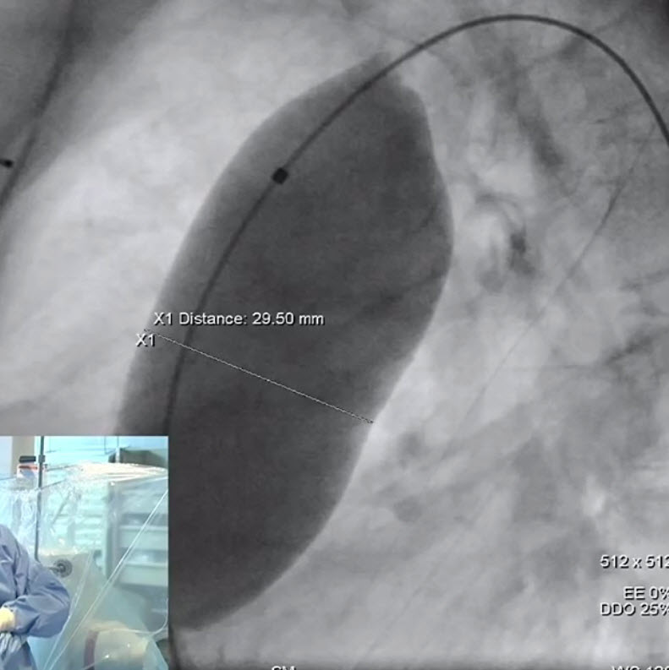
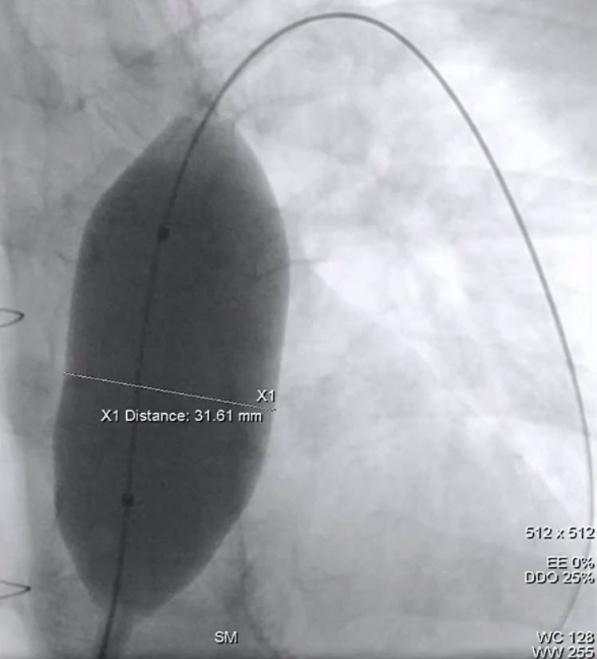
Landing zone sizing
Measured in multiple planes
Use compliant balloon catheter
Measured at the minimum diameter of the landing zone
Ensure final landing zone diameter doesn’t impinge on coronaries
Ensure a noncompliant landing zone
Eliminate any residual stenosis using standard techniques prior to placing the prosthesis
    To minimize the risk of conduit rupture, use caution when using a balloon with a diameter greater than the nominal diameter (original implant size) of the conduit for predilation of the intended deployment site.
NOTE

Slide 30
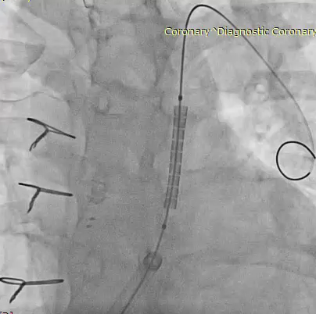
Prestenting considerations
Provides a landing zone for valve and treats the underlying stenosis, especially lesions longer than the valve frame
Helps maintain circular configuration
Predicts final sizing
Bare metal or covered
Pressure measurements
post-stent should reflect
minimal to no residual gradient
Click above to pause/play video

Slide 31
Pulmonic SAPIEN 3 THV sizing
Recommended sizing is based on the diameters measured in multiple views of the landing zone
29 mm THV
PULMONIC
26 mm THV
PULMONIC
23 mm THV
PULMONIC
20 mm THV
PULMONIC
Diameter (mm)
THV size | Noncompliant landing zone size during balloon predilation
20 mm | 16.5 - 20 mm
23 mm | 20 - 23 mm
26 mm | 23 - 26 mm
29 mm | 26 - 29 mm

Slide 32
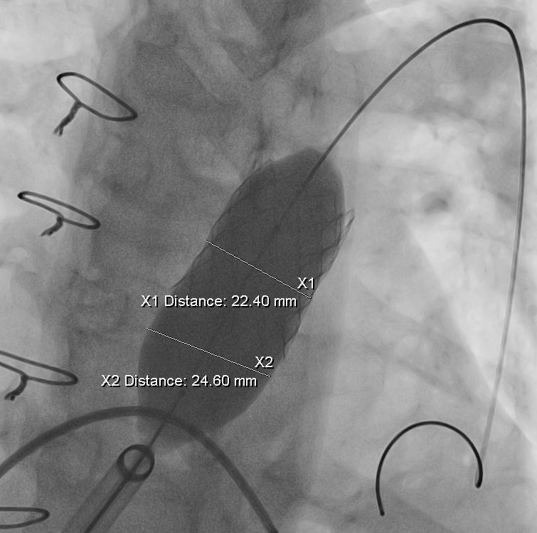
Pulmonic SAPIEN 3 THV sizing
In presence of presenting, prosthesis sizing should be based on the diameter of the balloon at full inflation

Slide 33
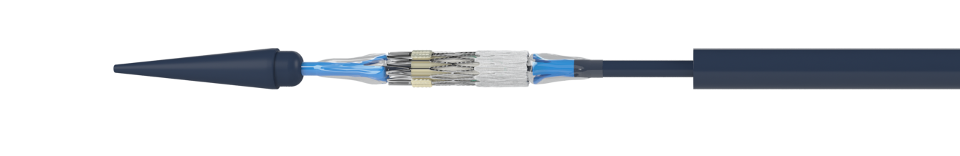

Verify pulmonic THV orientation
Verify THV orientation with the inflow (outer skirt) of
the THV towards the proximal end (handle)
of the delivery system
Valve orientation verification must be performed prior to advancing the valve capsule over the valve
Confirm valve is crimped between shoulders
Outflow
Inflow
Inflow
    The physician must verify correct orientation of the
    valve prior to its implantation.
Outflow
WARNING

Slide 34

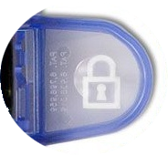

Verify correct delivery system volume
Verify the inflation volume with the volume indicated
by the printing on the gripper and the color coding
Verify inflation device is
locked prior to inserting
the delivery system
THV Size | Nominal Inflation Volume*
20 mm | 10 mL
23 mm | 15 mL
26 mm | 21 mL
29 mm | 29 mL
Colored gripper
* The delivery system requires a prescribed volume for THV deployment and proper function
Locked
    Maintain the inflation device provided by Edwards Lifesciences in the locked position until valve deployment.
CAUTION

Slide 35
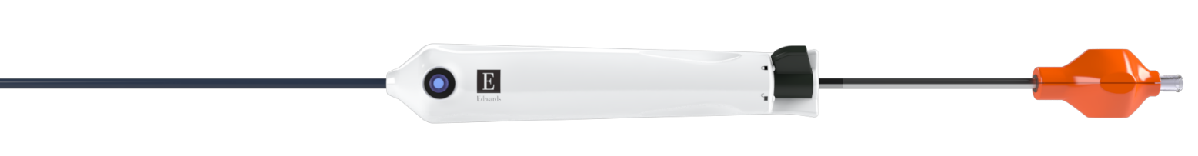
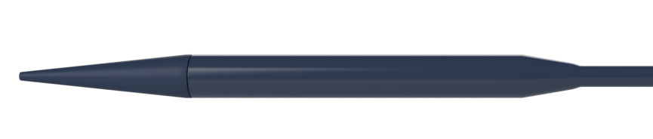
Delivery system and inline sheath insertion
Prior to insertion of the pulmonic valve delivery system:
Ensure tapered tip and valve capsule are hydrated to activate hydrophilic coating
Delivery system is in the locked position
Locked position
Ensure that there is no gap between the valve capsule and tapered tip
  If gap is present – unlock the delivery system and retract the balloon catheter until gap is closed
  Relock the delivery system
Remove existing sheath (including Edwards Expandable Introducer Sheath) and prepare venous anatomy with provided dilator
  Consider allowing the dilator to indwell
  for several minutes prior to insertion of the pulmonic delivery system
Capsule approximated to tapered tip

Slide 36
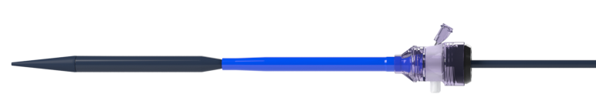
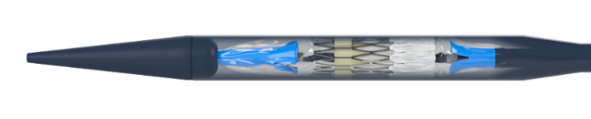
Delivery system and inline sheath insertion
Insert the tapered tip of the delivery system and the inline sheath as a unit until the inline sheath is fully inserted into the vasculature
  Tips for insertion
  Hold the delivery system on back half of capsule
  Ensure the tapered tip and valve capsule remain together until the capsule is inserted in the vasculature
Secure inline sheath
    If the nosecone and capsule become separated, remove the system and re-advance the outer capsule to the nosecone and ensure the delivery system is locked
    Do not force the inline sheath over the valve capsule
NOTE
Area for holding during insertion

Slide 37
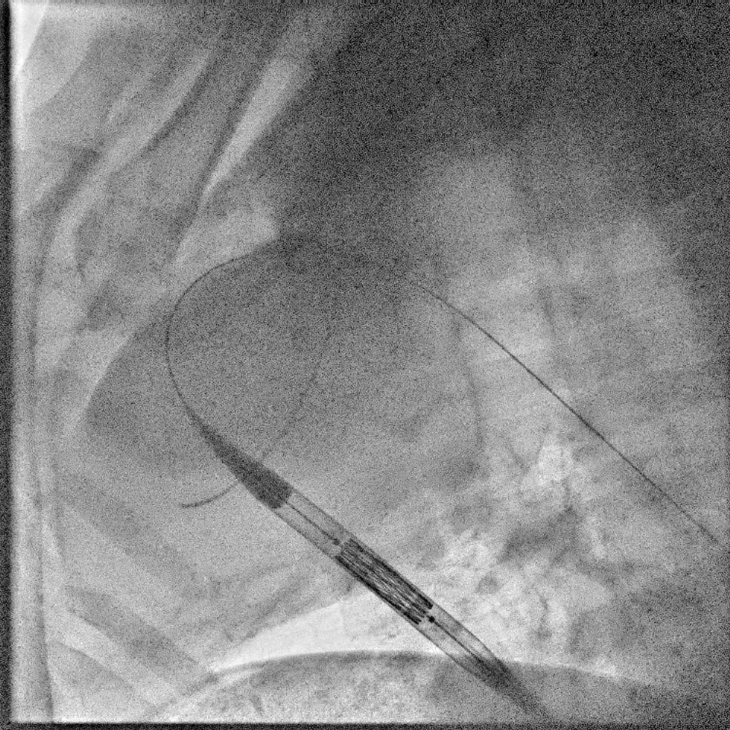
Tracking the THV into the landing zone
Advance the delivery system
Prior to tracking into the heart
  Visualize the valve within the capsule
    Ensure the valve is positioned between the shoulders
    Valve crimp shape is uniform
Maintain the valve capsule over the valve until the valve is positioned at the intended landing zone
    Do not force the inline sheath over the valve capsule.
NOTE
Click above to pause/play video
Animal model shown for illustration

Slide 38
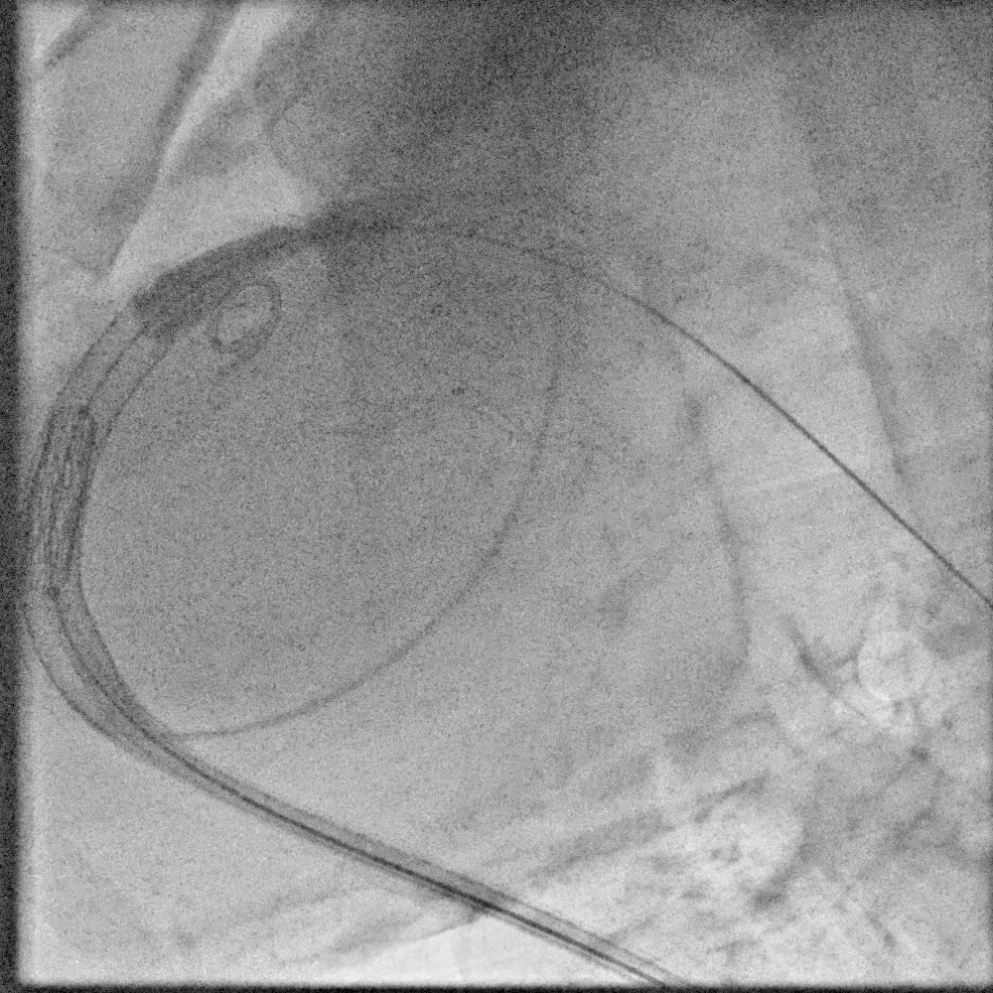
Tracking the THV into the landing zone
Use care when advancing the pulmonic delivery system to the intended landing zone
  Be aware of any potential gaps between the nosecone and the capsule of the delivery system
  Consider slowly reapproximating the nosecone and capsule if a gap is noted
Use wire techniques to
  Centralize the wire in the RVOT/MPA prior to advancing the pulmonic delivery system
Click above to pause/play video
Animal model shown for illustration
Alterra implant shown for illustrative purposes

Slide 39
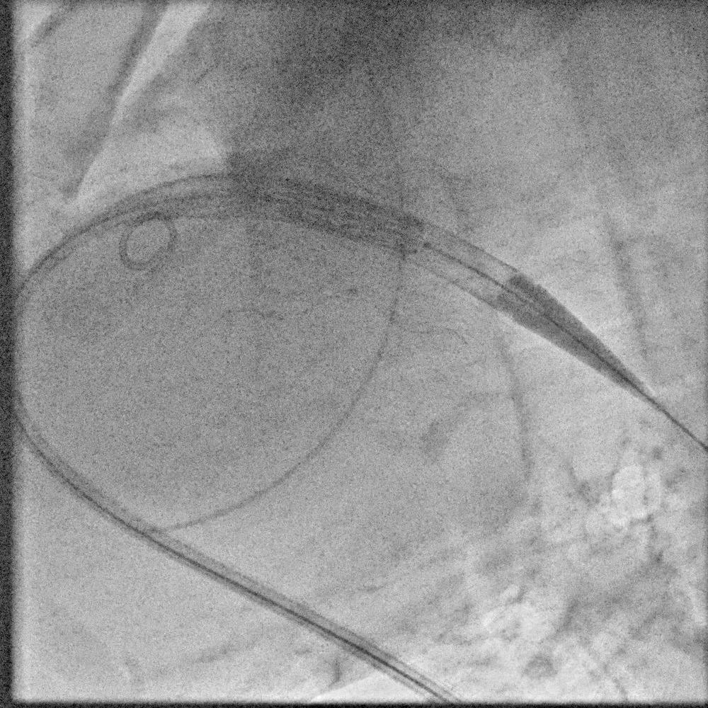
THV positioning
Continue advancing the pulmonic delivery system and position the THV completely within the landing zone
Avoid positioning the distal (outflow) half of the THV within any residual stenosis which may affect proper leaflet function
Use different fluoroscopic views, if uncertain about positioning
    Placement of the THV in the proximity of stenosis can result in THV movement during deployment.
NOTE
Click above to pause/play video
Animal model shown for illustration.
Alterra implant shown for illustrative purposes.

Slide 40

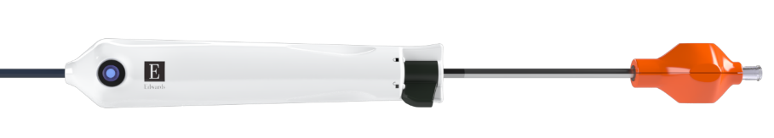
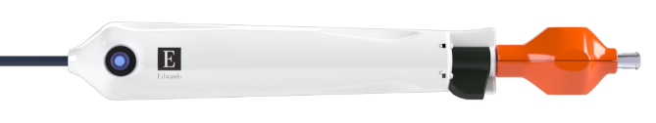
Retracting the valve capsule
Once the valve is positioned in the intended landing zone
To uncover the valve:
Step 1
Unlock the delivery system
Step 2
While maintaining the position of the balloon shaft retract the handle until the handle stops at the gripper
  The valve is fully uncovered when
  the handle meets the gripper
    Maintain inline sheath position
    Maintain guidewire position in the pulmonary artery during valve unsheathing to prevent loss of guidewire position
NOTE
Step 3
Relock the delivery system

Slide 41
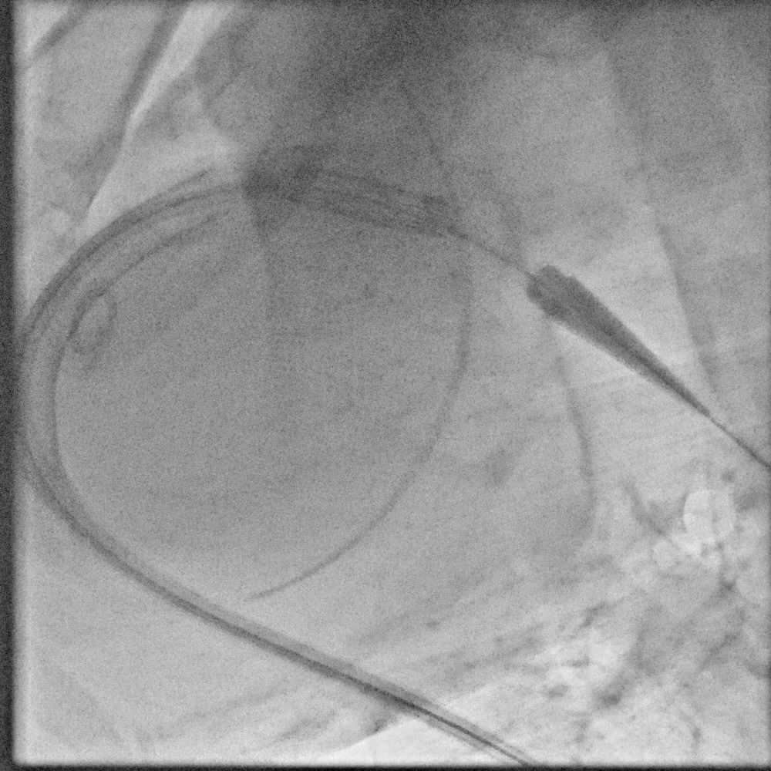
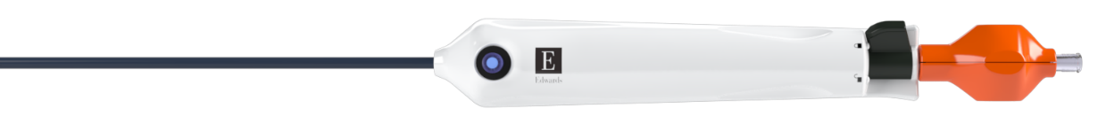
Verify position of THV
Under fluoroscopy verify the position of the THV within the intended landing zone
  The valve may move during uncovering
If additional positioning is required, ensure the delivery system is locked and maneuver the handle/balloon catheter as a unit
Ensure the handle and the gripper are together and locked prior to inflation
If unable to reposition the uncovered valve:
  Re-cover the valve with the capsule
  Once the valve is recovered, lock the handle, re-position the valve within the intended landing zone
  Retract the valve capsule as instructed on slide 40
Locked position
Click above to pause/play video
Animal model shown for illustration
Alterra implant shown for illustrative purposes

Slide 42

Rapid pacing protocol – Optional
Protocol for pulmonic THV deployment
Operator | Sequence | Verbal
Primary operator | THV in position | “Ready?”
Secondary operator | Unlock inflation device | “Ready”
Primary operator | Verify THV properly positioned | “Begin inflating”
Secondary operator | Begin slow, controlled inflation | “Inflating”
Primary operator | Assess THV position | “Hold”
Secondary operator | Stop inflation | “Holding”
Primary operator | Reposition THV as necessary | “Inflate”
Secondary operator | Continue slow, controlled inflation | “Inflating”
Primary operator | Confirm final THV position | “Fully inflate”
Secondary operator | Fully inflate, hold for 3 seconds, and deflate | “ 1… 2… 3… deflating”
    Secondary operator should only act on the direction of the primary operator.
Repeat as necessary
NOTE

Slide 43





THV deployment
Check to ensure:
Valve capsule is fully retracted prior to deployment
Gripper and the handle are touching
Delivery system is locked
  Unlock the inflation device
  Confirm positioning of the valve within intended landing zone
  Begin initial deployment with
  a slow controlled inflation
  Reposition THV
  as necessary
  Fully inflate and hold for 3 seconds to ensure complete deployment
  Completely deflate the
  balloon and withdraw
Additional considerations
Verify valve capsule is fully retracted and the handle and gripper are together
  Ensure full inflation of balloon
  during deployment
  Ensure stability of delivery system during THV deployment
Slow inflation during initial deployment may help with stability of the delivery system and THV during deployment
If considered, reposition only at the very early stage of deployment
Always maintain control of the plunger of inflation device when releasing it
Never lock the inflation device during balloon pre-dilation or THV deployment
3 Sec

Slide 44

THV deployment
SAPIEN 3 THV deployment characteristics
Possible movement during initial deployment
  A slow, controlled inflation during initial deployment may help with stability of the
  delivery system and THV
Foreshortening visible toward the end of
THV deployment
THV Size | Crimped height¹ | Expanded height | Foreshortening
20 mm | 21 mm | 15.5 mm | 5.5 mm
23 mm | 24.5 mm | 18 mm | 6.5 mm
26 mm | 27 mm | 20 mm | 7 mm
29 mm | 31 mm | 22.5 mm | 8.5 mm
Click above to pause/play video
¹ Rounded to the nearest 0.5
Animal model shown for illustration
Alterra implant shown for illustrative purposes

Slide 45

Post-dilation (if necessary)
Consider post-dilation if paravalvular jets are clinically significant
Post-dilate with the pulmonic delivery system if not previously removed or other commercially available balloon catheter
If using the pulmonic delivery system, utilize the radiopaque shoulder markers to position the balloon within the THV prior to inflation
Shoulder markers
    If regurgitation is central rather than paravalvular, DO NOT post-dilate.
NOTE

Slide 46

Withdrawing the SAPIEN 3 Pulmonic delivery system
Once the balloon is fully deflated retract the delivery system into the vena cava
It is recommended to have the tapered tip in the center of the valve when retracting
  Ensure the tapered tip does not engage previously implanted devices
  Wire manipulation may assist in positioning the tapered tip in the center of the valve
If resistance is met upon retraction of the tapered tip:
  Stop – ensure the tapered tip is not engaged with any in situ devices
  Re-center the tapered tip and attempt removal again
  If unable to re-center the tapered tip, consider wire exchange for a softer wire
Care should be used to maintain the wire and
inline sheath position
Click above to pause/play video
Animal model shown for illustration
Predicate devices shown for illustrative purposes

Slide 47




SAPIEN 3 Pulmonic delivery system removal
When the delivery system is in the vena cava (under fluoro), re-sheath the balloon by retracting the gripper until the edge of the valve capsule is touching the tapered tip
Unlock the delivery system lock
Retract the balloon catheter until the end of travel is reached and the balloon shaft marker is exposed
Lock the delivery system
Click above to pause/play video
    Completely cover the balloon prior to removal to minimize the risk of vascular injury.
Balloon shaft marker
Animal model shown for illustration
Predicate devices shown for illustrative purposes
CAUTION

Slide 48

SAPIEN 3 Pulmonic delivery system removal
1
Inflation device unlocked
2
Unlock the delivery system lock
3
Retract the balloon catheter until the end of travel is reached and the balloon shaft marker is exposed
4
If unable to completely retract the balloon shaft
  Advance the balloon shaft
  Rotate the balloon
  Retract the balloon shaft into
  the valve capsule
5
Lock the delivery system
Click above to pause/play video

Slide 49
Difficulty retracting balloon into valve capsule
If difficulty is experienced when attempting to recover the balloon catheter
Balloon rotation technique
Neutral pressure technique
Balloon re-folding technique
  Advance the balloon shaft
  Rotate the balloon
  Retract the balloon shaft into the valve capsule
  Advance the balloon shaft
  Place the inflation device at neutral pressure
  Retract the balloon shaft into the valve capsule
  Advance the balloon shaft
  Inflate with a small amount
  of volume
  Deflate the balloon
  Retract the balloon shaft into the valve capsule

Slide 50

SAPIEN 3 Pulmonic delivery system removal
Continue to retract the delivery system until the capsule meets the inline sheath tip
Retract the entire system (inline sheath and delivery system) together out of the vasculature
Replace system with standard vascular access sheath, e.g., Gore DrySeal or other large bore sheath per physician preference
THV size | Catheter capsule outer diameter
20 mm | 25.1Fr / 8.4 mm
23 mm | 27.1Fr / 9.0 mm
26 mm | 27.1Fr / 9.0 mm
29 mm | 28.5Fr / 9.5 mm

Slide 51

Post-deployment THV assessment
Assess the valve post-deployment using fluoroscopy
Withdraw the delivery system from the valve before assessing
Perform post-angiogram with wire still in position
to assess
  Valve position and expansion
  Patency of coronary arteries
  Functional assessment of valve (central leak, PVL, etc.)
Perform pressure assessment
Close vasculature per physician preference
    Stiff wire tends to exacerbate central regurgitation.
    Use of excessive contrast media may lead to renal failure. Measure the patient’s creatinine level prior to the procedure. Contrast media usage should be monitored.
NOTE
CAUTION
Click above to pause/play video

Slide 52
Intraprocedural considerations

Slide 53

Removing undeployed delivery system
Prior to removal of the delivery system from the anatomy the valve must be covered by
the capsule
Considerations for location
to recover the valve
  Valve location within the pulmonary artery
  Stability of the any
  previously implanted stents/devices
  Valve and capsule location anatomically
    Position of the capsule in
    respect to the tricuspid valve
    and surrounding anatomy
Ensure the delivery system freely moves upon retraction into the vena cava
Continue to retract the delivery system until the capsule meets the inline sheath tip
Retract the entire system (inline sheath and delivery system) together out of the vasculature
    Equipment will need to be ready to insert into vasculature prior to removal of the pulmonic valve delivery system.
    Completely cover the balloon prior to removal to minimize the risk of vascular injury.
NOTE
CAUTION

Slide 54
Balloon rupture
If delivery system balloon ruptures or leaks during deployment without THV embolization
Do not use excessive force take care when crossing the THV and tracking through the anatomy
Based on an assessment of the size and tortuosity of the pulmonary artery anatomy, evaluate the risks and tradeoffs of the following delivery system retrieval options
Maintain guidewire position
Check for paravalvular or central leaks utilizing echo
If post-dilation needed, use a new delivery system or other commercially available balloon catheter
Option 1
Option 2
  Utilize snare technique (must be performed prior to attempting retrieval into the capsule)
    If the tear is radial, it may umbrella and make retrieval into the capsule extremely difficult
    Utilization of the snare prior to attempting to retrieve a radial tear may reduce the profile of the balloon for removal
  Retract the delivery system into the
  vena cava
    Once in the vena cava and retrieve the delivery system (through the tip of the sheath)
    Attempt to snare the ruptured balloon in the vena cava prior to retraction into the capsule

Slide 55






Balloon rupture: Snaring in pulmonary artery
3
1
2
3
4
Balloon should remain in the pulmonary artery if the patient is hemodynamically stable.
Access the
distal PA via the contralateral femoral. Insert single loop snare.
Retract guidewire until it is flush with nosecone but no further. Position the snare distal to nosecone
Maneuver the opened snare over the distal end of the delivery system. Gently tighten snare while over the distal end of the balloon (approximately the level of the distal balloon shoulder marker)
5
5
6
7
    After snaring balloon, guidewire position may be adjusted outside of delivery system to maintain wire access.
    Do not allow snare to drag across femoral bifurcation during removal
Retract the delivery system and snare into the vena cava.
Retract the delivery system while advancing catheter/snare until the delivery system is in the femoral.
Once in femoral, attempt full recapture of the balloon into the capsule or convert to vascular surgery for device removal.
NOTE
    Do not apply excessive force if any resistance is encountered.
WARNING

Slide 56
Pulmonary perforation
Overview
Risk factors
Symptoms & diagnostics
Prevention overview
  Rare but serious complication that is avoidable with good wire practices
  Stiff wires
  Wire manipulation
  Wire replacement
  Will see contrast extravasation
  Large perforations may result in hemodynamic changes
  Wire control, use the softest wire possible, observe wire position at all times
  If perforation occurs, treatment depends on location and size of perforation
    Small: Watch and wait
    Large: Covered stent, vascular occlusion devices, balloon tamponade

Slide 57
Embolization of device
  Maintain guidewire position through the device
Assess patient hemodynamic stability
If embolization into the ventricle, consider CPB and surgical intervention
If embolization further into the pulmonic artery assess stability – if needed, consider CPB and surgical intervention

Slide 58
CAUTION: Federal (United States) law restricts these devices to sale by or on the order of a physician. See Instructions for Use for full prescribing information, including indications, contraindications, warnings, precautions, and adverse events.
The clinicians demonstrating Edwards Lifesciences technology in this training material may have received compensation and/or travel reimbursement from Edwards in exchange for providing professional services to Edwards.
Edwards, Edwards Lifesciences, the stylized E logo, Carpentier-Edwards, Edwards Commander, Edwards SAPIEN, Edwards SAPIEN XT, Edwards SAPIEN 3, eSheath, eSheath+, Qualcrimp, SAPIEN, SAPIEN XT, SAPIEN 3, and ThermaFix are trademarks or service marks of Edwards Lifesciences Corporation. All other trademarks or service marks are the property of their respective owners.
© 2025 Edwards Lifesciences Corporation. All rights reserved.

