Slide 1
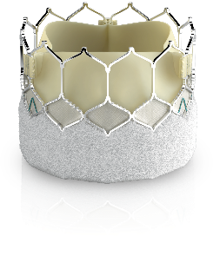
Edwards SAPIEN 3 Ultra valve

Slide 2
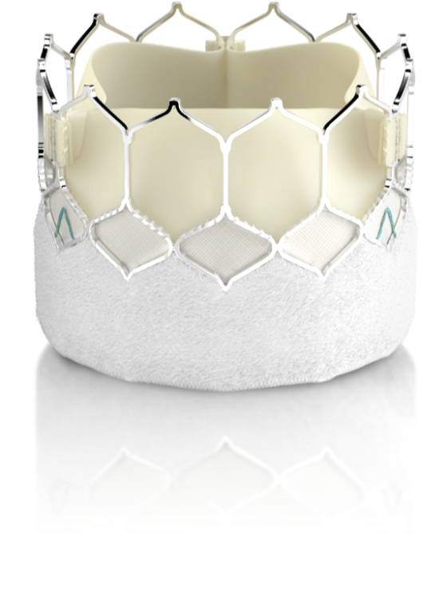
Elevating the expectations of what is possible
TAVI is built upon:
Clinical study
Real world experience
25,000+
patients studied in
Edwards clinical trials
450,000+
patients treated worldwide with Edwards TAVI valves
SAPIEN 3 Ultra valve
Data on file at Edwards Lifesciences
2

Slide 3
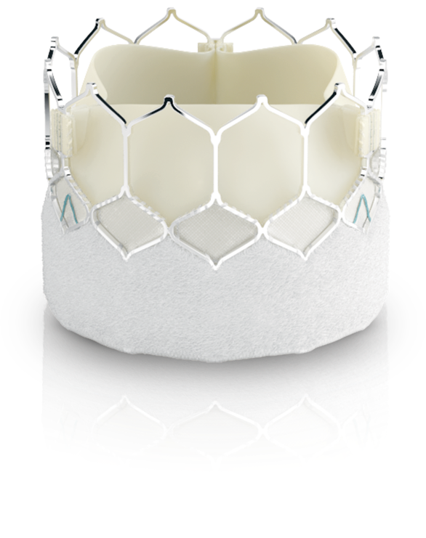
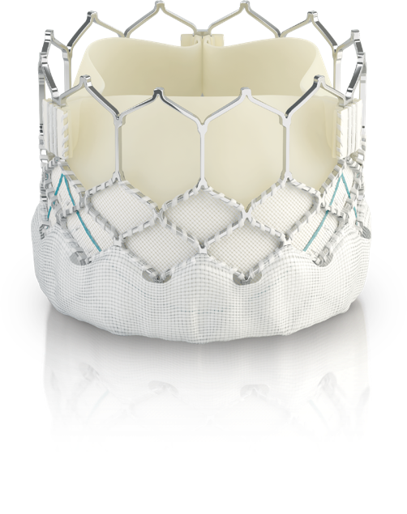
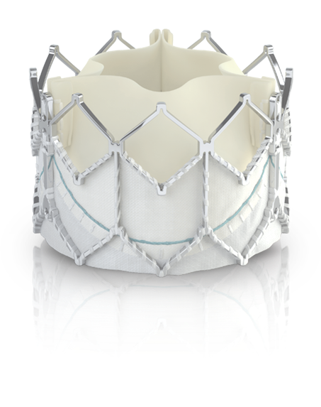
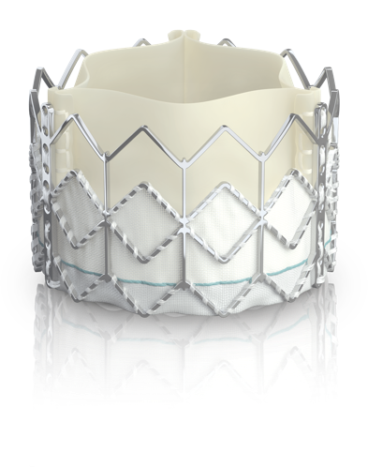
Your expectations change. Edwards Lifesciences continues to deliver.
Save lives, starting with the sickest patients
Extend life-saving treatment to even more
Reset the bar to be superior to surgery
Continue to meet the emerging needs of new patient populations
Ask
2007
2020
SAPIEN valve
Introducing TAVI as a life-saving treatment option for patients that are inoperable or high-risk for surgery¹
SAPIEN XT valve
Non inferior to surgery on mortality and stroke in intermediate risk patients²
SAPIEN 3 valve
The only THV proven superior to surgery for low risk patients³
SAPIEN 3 Ultra valve
Further reducing PVL, reaching new patients with expanded indications⁴
Response
1. Leon MB, Smith CR, Mack MJ, et al. Transcatheter Aortic-Valve Implantation for Aortic Stenosis in Patients Who Cannot Undergo Surgery. N Engl J Med. 2010.
2. Leon MB, Smith CR, Mack MJ, et al. Transcatheter or Surgical Aortic-Valve Replacement in Intermediate-Risk Patients. N Engl J Med. 2016.
3. Mack MJ, Leon MB, Thourani VH, et al. Transcatheter Aortic-Valve Replacement with a Balloon-Expandable Valve in Low-Risk Patients. N Engl J Med. 2019.
4. Nazif T, Daniels D, McCabe J, Chehab B, et al. Real-world experience with the SAPIEN 3 Ultra TAVI: A propensity matched analysis from the United States. Presented virtually at TVT Connect 2020.

Slide 4
Edwards SAPIEN 3 Ultra System
SAPIEN 3 Ultra valve¹ | Commander delivery system | e-Sheath set
Featuring a taller, textured PET outer skirt² | Physician controlled dual articulation with tapered distal tip | Low profile 14F access with Dynamic Expansion Mechanism (DEM)
Delivering the outcomes you demand
1 Available in 20, 23 and 26mm sizes
2 Compared to the Edwards SAPIEN 3 valve

Slide 5
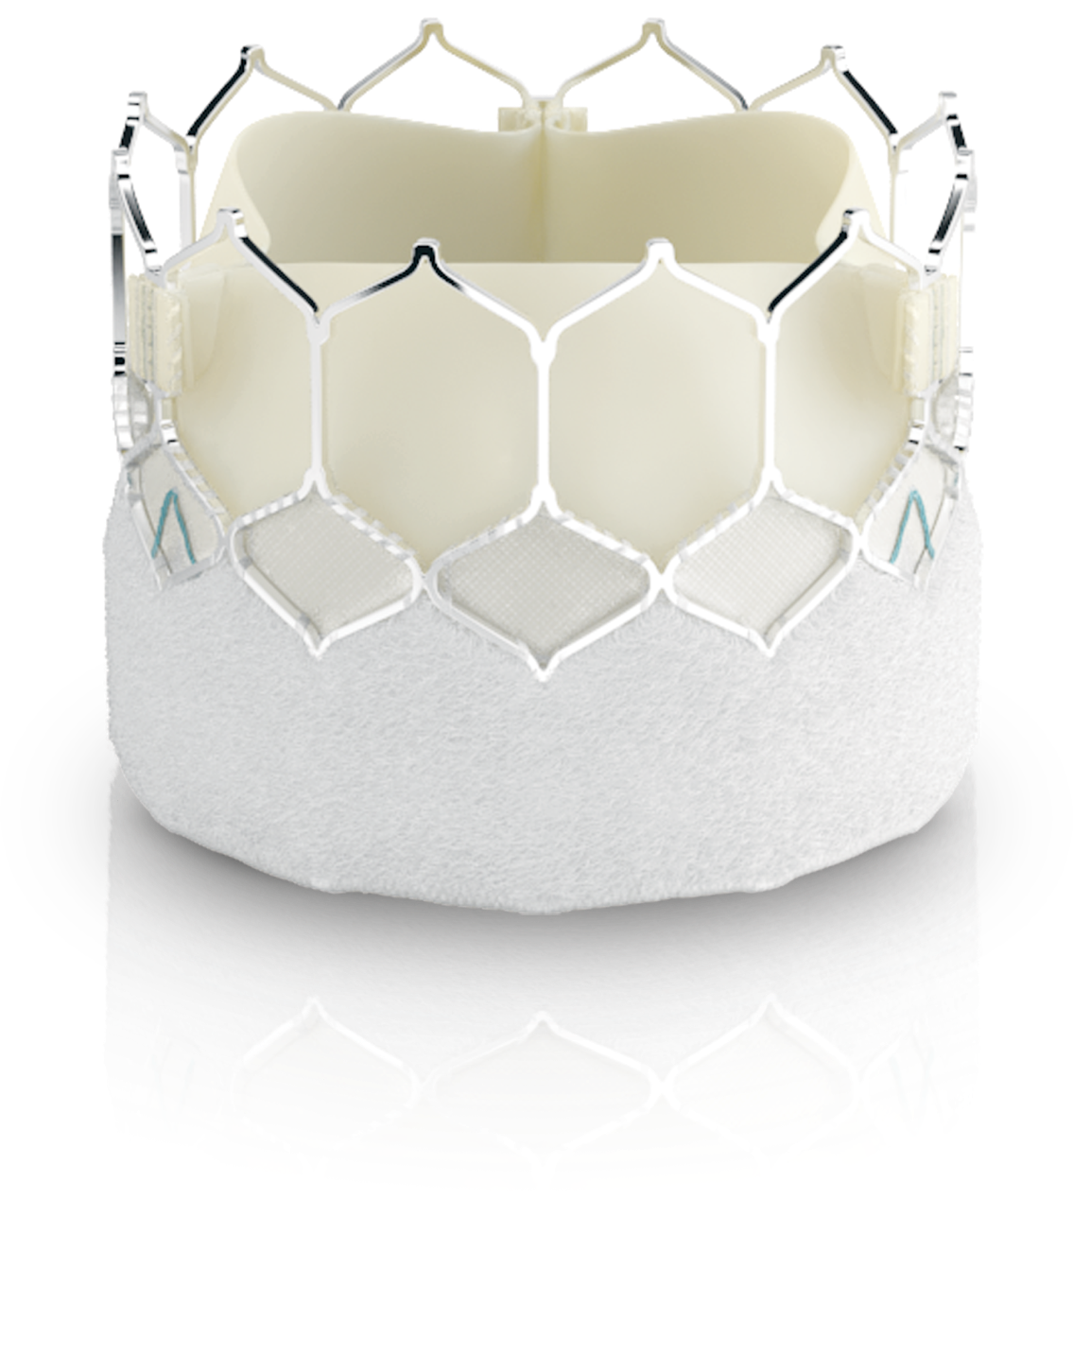
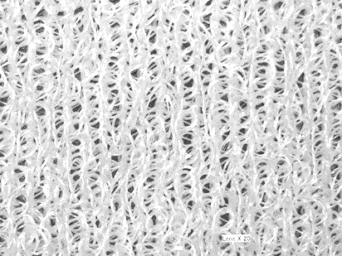
SAPIEN 3 Ultra valve Building on the standard in TAVI to meet the needs of today
Same frame and leaflet design¹
Taller, textured outer skirt
High radial strength frame
Matched, bovine pericardial leaflets
Large, open cells
Approximately 40% increased outer skirt height¹
Textured PET material
14F sheath compatibility²
1. Compared to the Edwards SAPIEN 3 valve
2. For 20, 23, and 26 mm sizes

Slide 6
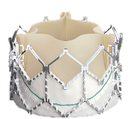
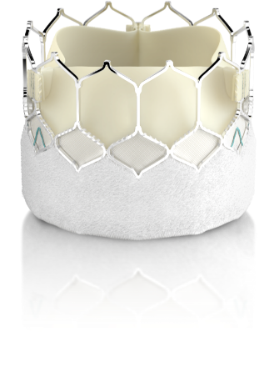
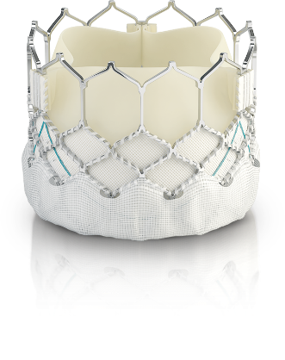
Delivering on the changing expectations of TAVI
Moderate or severe PVL at 30 days
0.5%
⁴
SAPIEN valve
SAPIEN XT valve
SAPIEN 3 valve
SAPIEN 3 Ultra valve
1. Leon MB, Smith CR, Mack MJ, et al. Transcatheter aortic-valve implantation for aortic stenosis in patients who cannot undergo surgery. N Engl J Med. 2010;363(17):1597-1607.
2. Leon MB, Smith CR, Mack MJ, et al. Transcatheter or surgical aortic-valve replacement in intermediate-risk patients. N Engl J Med. 2016;374(17):1609-1620.
3. Mack MJ, Leon MB, Thourani VH, et al. Transcatheter aortic-valve replacement with a balloon-expandable valve in low-risk patients. N Engl J Med. 2019;380(18):1695-1705.
4. Nazif T, Daniels D, McCabe J, Chehab B, et al. Real-world experience with the SAPIEN 3 Ultra TAVI: A propensity matched analysis from the United States. Presented virtually at TVT Connect 2020.

Slide 7
Designed to meet the PVL outcomes you demand
In a large real-world registry of 1,324 patients the SAPIEN 3 Ultra valve demonstrated¹:
The SAPIEN 3 Ultra valve is engineered to further reduce PVL
0.2% ≥ moderate
8.9% mild
90.9% none
99% deployment accuracy in the intended location²
Balloon expandable deployment and an enhanced outer skirt, to maximize contact
Cobalt-chromium frame for high radial strength
Discharge Paravalvular Regurgitation
(n=1,115)
Nazif T, Daniels D, McCabe J, Chehab B, et al. Real-world experience with the SAPIEN 3 Ultra TAVR: A propensity matched analysis from the United States. Presented virtually at TVT Connect 2020.
Data on file. The PARTNER II Trial intermediate-risk cohort 30-day unadjusted clinical event rates for TAVR with the SAPIEN 3 valve, AT population (n=1077)

Slide 8
Consistent low values for moderate PVL: Outcomes at 30 days and 1 year
30-day outcomes
1-year outcomes
PARTNER 3 Trial¹
N=487
S3U Registry²
N=139
S3U TVT Registry³
N=1,324
PARTNER 3 Trial¹
N=487
Mack MJ, Leon MB, Thourani VH, et al. Transcatheter aortic-valve replacement with a balloon-expandable valve in low-risk patients. N Engl J Med. 2019.
Saia F, et al. In-hospital and thirty day outcomes of the SAPIEN 3 Ultra balloon-expandable TAVR: the S3U registry. Eurointervention 2020.
Nazif T, Daniels D, McCabe J, Chehab B, et al. Real-world experience with the SAPIEN 3 Ultra TAVI: A propensity matched analysis from the United States. Presented virtually at TVT Connect 2020

Slide 9
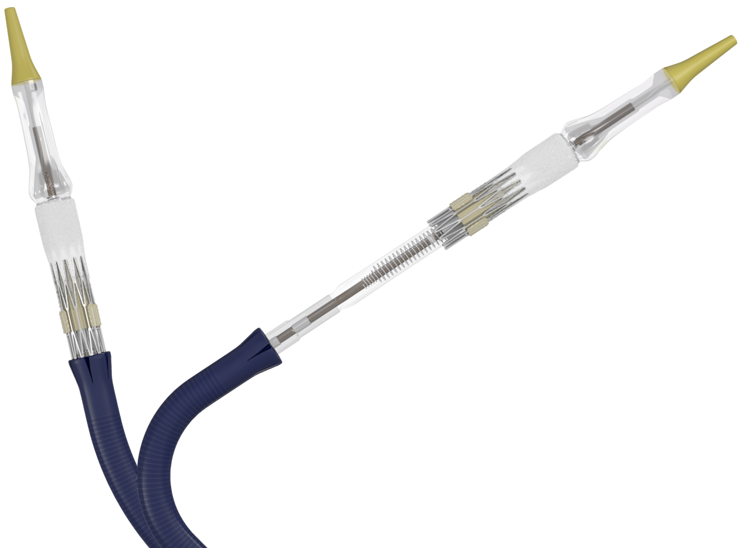
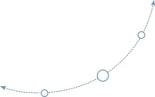
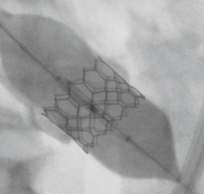
Edwards Commander Delivery System A delivery system designed to keep you in control
Predictability and control, to meet the increasing complexity of your procedures
Stable, precise deployment
6.0%
Permanent pacemaker rate at 30 days¹
Distal flex to help cross in any anatomy
The only delivery system to offer controlled articulation n=1,324
Dual articulation for tracking and coaxiality
Balloon-expandable platform delivers stable, precise deployment
Nazif T, Daniels D, McCabe J, Chehab B, et al. Real-world experience with the SAPIEN 3 Ultra TAVI: A propensity matched analysis from the United States. Presented virtually at TVT Connect 2020

Slide 10
Predictability and control, to further reduce the risk of conduction disturbances
Globally consistent, single-digit new permanent pacemaker rates
3M Study¹ n=411 | FAST-TAVI² n=466 | S3U Registry³ n=139 | OCEAN Registry⁴ n=376 | TVT Registry⁵ n=1,324
Wood, DA, Lauck SB, Cairns JA, et al. The Vancouver 3M (multidisciplinary, multimodality, but minimalist) clinical pathway facilitates safe next-day discharge home at low-, medium-, and high-volume transfemoral transcatheter aortic valve replacement centers: the 3M TAVI study. J Am Coll Cardiol Intv. 2019;12(5):459-469.
Barbanti M, van Mourik MS, Spence MS, et al. Optimising patient discharge management after transfemoral transcatheter aortic valve implantation: the multicentre European FAST-TAVI trial. EuroIntervention. 2019;15:147-154.
Saia F, et al. In-hospital and thirty day outcomes of the SAPIEN 3 Ultra balloon-expandable TAVR: the S3U registry. Eurointervention 2020.
Yamamoto M, Watanabe Y, Tada N, et al. Transcatheter aortic valve replacement outcomes in Japan: optimized catheter valvular intervention (OCEAN) Japanese multicenter registry. Cardiovasc Revasc Med. 2019;20(10):843-851.
Nazif T, Daniels D, McCabe J, Chehab B, et al. Real-world experience with the SAPIEN 3 Ultra TAVR: A propensity matched analysis from the United States. Presented virtually at TVT Connect 2020.

Slide 11
Low pacemaker rates mean better outcomes for your patients
New pacemaker after TAVI is associated with a 31% increase in mortality in the first year¹
New pacemaker after TAVI is associated with a 42% increase in rehospitalization at 4 years²
30
HR: 1.31 (95% CI: 1.09-1.58)
P = 0.003
60
HR: (95% CI: 1.42 (1.06-1.89)
P = 0.019
PPM
No PPM
30-day PPI
No PPI
20
40
Mortality cumulartive incidence, %
Rehospitalization for heart failure (%)
26.1%
10
20
17.5%
0
0
0
3
6
9
12
0
12
24
36
48
Months since index procedure
Months follow-up
No. of events/No. at risk
Patients at risk
PPM
No PPM
0/651
0/9134
81/450
878/7489
104/265
1173/6071
112/118
1360/5086
114/42
1536/4276
30-day PPI
No PPI
322
1307
246
1064
197
923
127
624
89
397
1. Fadahunsi OO, Olowoyeye A, Ukaigwe A, et al. Incidence, predictors, and outcomes of permanent pacemaker implantation following transcatheter aortic valve replacement – Analysis from the U.S. Society of Thoracic Surgeons/American College of Cardiology TVT Registry. JACC: Cardiovasc Interv. 2016;9(21):2189-2199.
2. Chamandi, C, Barbanti M, Munoz-Garcia A, et al. Long-term outcomes in patients with new permanent pacemaker implantation following transcatheter aortic valve replacement. JACC: Cardiovasc Interv. 2018;11(3):301-310.

Slide 12
Edwards eSheath Introducer Set Low profile and expandable, to reduce complications
14F for entire procedure, no sheath exchanges required.
2.2%
Major vascular complications n=139
14F
Low profile
5.5 mm
Minimum access vessel diameter
Transient dynamic expansion, to reduce vessel stress
SAPIEN 3 Ultra Valve Size | 20 mm | 23 mm | 26 mm
Edwards eSheath Introducer set | 14F | 14F | 14F
Minimum access vessel diameter | 5.5 mm | 5.5 mm | 5.5 mm
Saia F, et al. In-hospital and thirty day outcomes of the SAPIEN 3 Ultra balloon-expandable TAVR: the S3U registry. Eurointervention 2020.

Slide 13
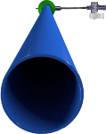
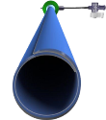
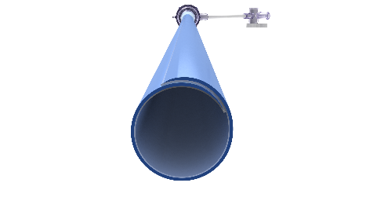
Reducing vascular complications with low profile introducer
30-day major vascular complications
Inoperable
High risk
Intermediate
Low risk
SAPIEN valve
SAPIEN XT valve
SAPIEN 3 valve
SAPIEN 3 Ultra valve
P1B (TF)¹ 179 | P1A² 348 | P2B (TF)³ 276 | P2B (TF)³ 284 | P2A⁴ 1,011 | P2 HR⁵ 583 | P2 S3i⁵ 1,078 | P3 LR⁶ 496 | TVT Registry⁷ 1324
22F
16F
14F
Leon MB, Smith CR, Mack M, et al. Transcatheter aortic-valve implantation for aortic stenosis in patients who cannot undergo surgery. N Engl J Med. 2010;363(17):1597-1607.
Smith CR, Leon MB, Mack MJ, et al. Transcatheter versus Surgical Aortic-Valve Replacement in High-Risk Patients. N Engl J Med. 2011;364:2187-2198.
Webb JG, Doshi D, Mack MJ, et al. A randomized evaluation of the SAPIEN XT transcatheter heart valve system in patients with aortic stenosis who are not candidates for surgery. JACC Cardiovasc Interv. 2015;8(14):1797-1806.
Leon MB, Smith CR, Mack MJ, et al. Transcatheter or surgical aortic-valve replacement in intermediate-risk patients. N Engl J Med. 2016;374:1609-1620.
Kodali S, Thourani VH, White J, et al. Early clinical and echocardiographic outcomes after SAPIEN 3 transcatheter aortic valve replacement in inoperable, high-risk and intermediate-risk patients with aortic stenosis. Eur Heart J. 2016;37(28):2252-2262.
Mack M, Leon M, Thourani R, et al. Transcatheter aortic-valve replacement with a balloon-expandable valve in low-risk patients. N Engl J Med 2019;380:1695-705.
Nazif T, Daniels D, McCabe J, Chehab B, et al. Real-world experience with the SAPIEN 3 Ultra TAVI: A propensity matched analysis from the United States. Presented virtually at TVT Connect 2020

Slide 14
SAPIEN 3 Ultra is designed to deliver the outcomes you demand
Delivering outcomes your patients can count on:
30 days
n=1324 | S3U TAVI¹
All-cause mortality | 0.9%
All-cause stroke | 1.2%
Rehospitalization | 4.4%
New permanent pacemaker | 6.0%
Major vascular complication | 1.1%
Life-threatening bleeding | 0.0%
Mortality
Stroke
Rehospitalization
Bleeding
Nazif T, Daniels D, McCabe J, Chehab B, et al. Real-world experience with the SAPIEN 3 Ultra TAVI: A propensity matched analysis from the United States. Presented virtually at TVT Connect 2020

Slide 15
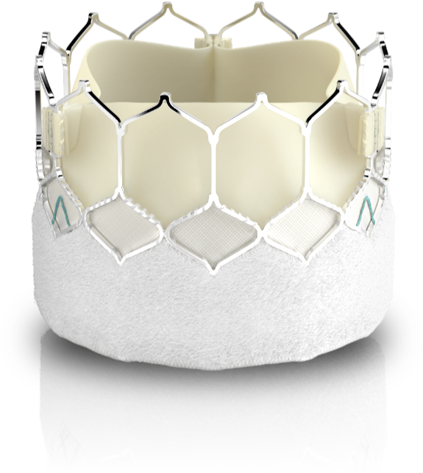
Edwards SAPIEN 3 Ultra TAVI
You take outcomes to new heights.
We’re right there with you.
SAPIEN 3 Ultra TAVI helps you deliver the outcomes you demand:
Low mortality and stroke comparable to SAVR
Minimal moderate/severe PVL
Globally consistent, single-digit new permanent pacemaker rates
Choose SAPIEN 3 Ultra TAVI. The valve designed to meet your higher standard.
15

Slide 16
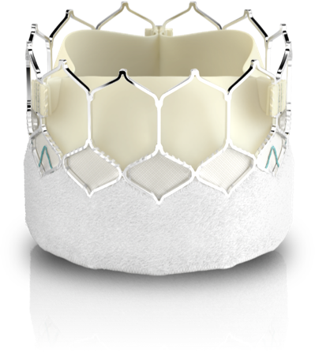
Welcome to the Higher Standard.
Your Standard.
Edwards SAPIEN 3 Ultra valve

Slide 18
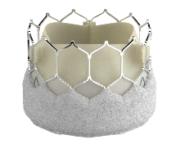
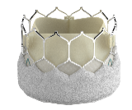
Edwards SAPIEN 3 Ultra System Complete range of valve sizes
Valve size | 20 mm | 23 mm | 26 mm | 29 mm
Valve | SAPIEN 3 Ultra | SAPIEN 3 Ultra | SAPIEN 3 Ultra | SAPIEN 3
Native Annulus Size by TEE* | 16 – 19 mm | 18 – 22 mm | 21 – 25 mm | 24 – 28 mm
Native Annulus Area (CT)* | 273 – 345 mm² | 338 – 430 mm² | 430 – 546 mm² | 540 – 683 mm²
Area-derived Diameter (CT)* | 18.6 – 21 mm | 20.7 – 23.4 mm | 23.4 – 26.4 mm | 26.2 – 29.5 mm
Edwards eSheath Introducer set | 14F | 14F | 14F | 16F
Minimum access vessel diameter | 5.5 mm | 5.5 mm | 5.5 mm | 6.5 mm
*Unchanged between SAPIEN 3 and SAPIEN 3 Ultra valve
CT, computed tomography; TEE, Transesophageal echocardiogram

Slide 19
For professional use. See instructions for use for full prescribing information, including indications, contraindications, warnings, precautions, and adverse events. (consult eifu.edwards.com where applicable).
Edwards Lifesciences devices placed on the European market meeting the essential requirements referred to in Article 3 of the Medical Device Directive 93/42/EEC bear the CE marking of conformity.
Material not intended for distribution in USA or Japan.
Edwards, Edwards Lifesciences, the stylized E logo, Edwards Commander, Edwards eSheath, Edwards SAPIEN, Edwards SAPIEN 3, Edwards SAPIEN 3 Ultra, PARTNER, PARTNER II, PARTNER 3, SAPIEN, SAPIEN XT, SAPIEN 3 and SAPIEN 3 Ultra are trademarks or service marks of Edwards Lifesciences Corporation. All other trademarks are the property of their respective owners.
These materials are sponsored solely by Edwards and were not authorized by any other manufacturer.
© 2021 Edwards Lifesciences Corporation. All rights reserved. PP--EU-1643 v1.0

